Slide 1
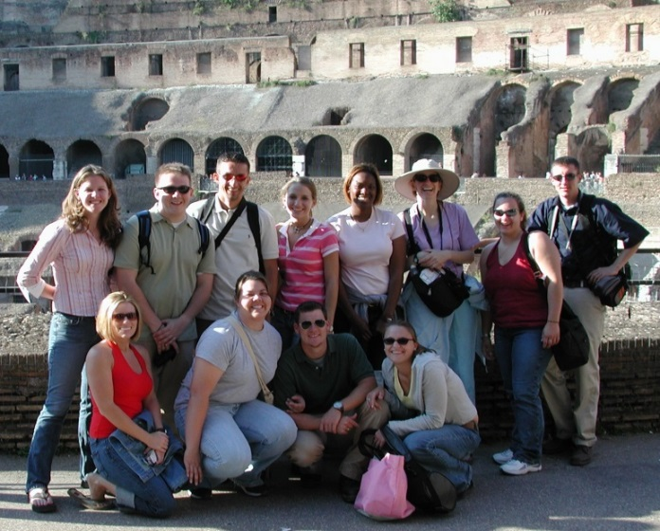
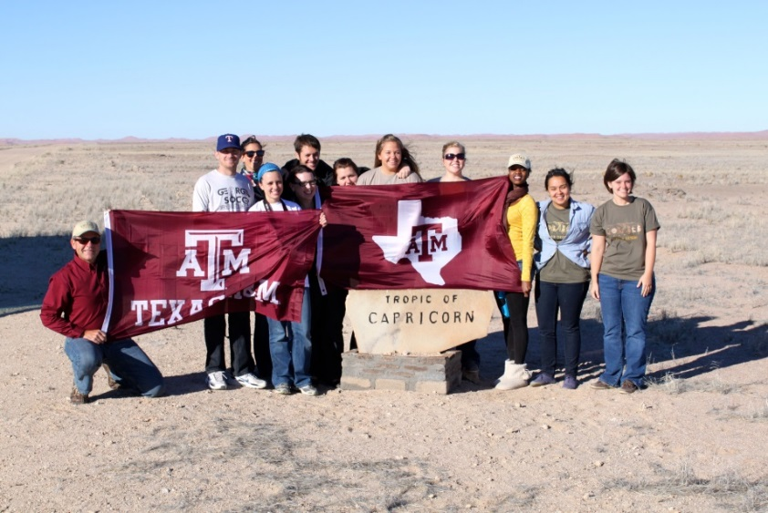
Creating International Opportunities for Aggies:
An Introduction for
Texas A&M Faculty
Study Abroad Programs Office

Slide 2
Demographics of student participation
In AY 2016:
  5530 students participated on international programs or experiences;
  1949 students enrolled in classes taught by TAMU faculty overseas;
  1637 students enrolled in on-campus courses that included an international component;
  257 students conducted research overseas;
In short, most Aggies go abroad with, or under the direction of, TAMU faculty.

Slide 3
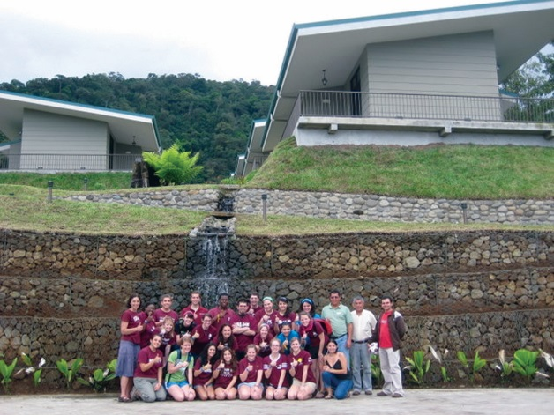
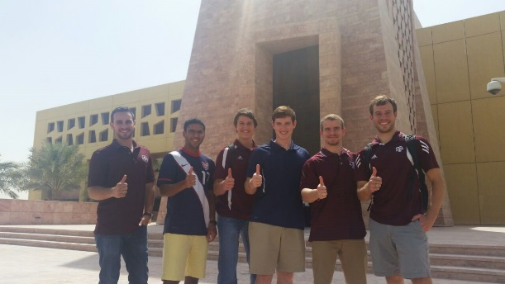

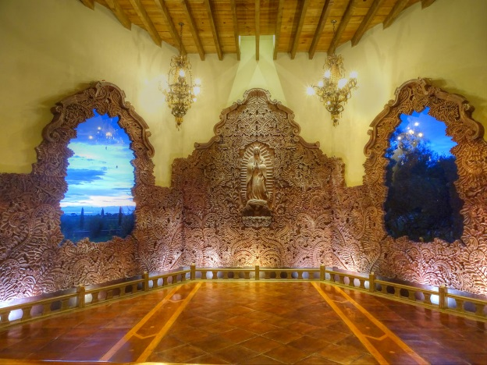
Frequently used locations
Soltis Center for Education and Research,
Costa Rica;
Texas A&M University, Qatar;
Santa Chiara Study Center, Italy;
Hacienda Santa Clara, Mexico.

Slide 4
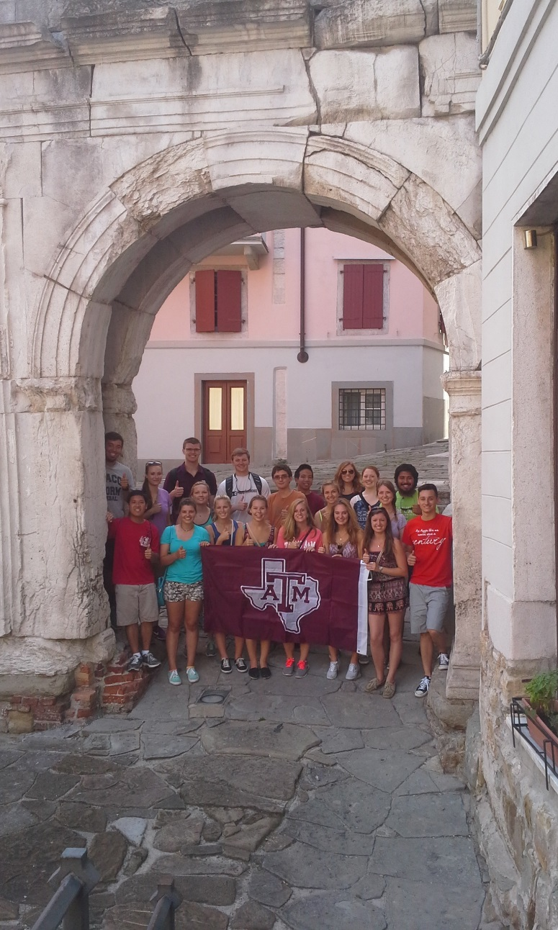
Different types of study abroad opportunities
Programs can be as short as a week, or as long as a semester;
Courses with more than 50% of the contact hours taught overseas are Faculty-led programs;
Courses taught primarily on campus with an international component are Field Trips;
Faculty or departments can assist students in developing directed or independent Research Abroad.

Slide 5
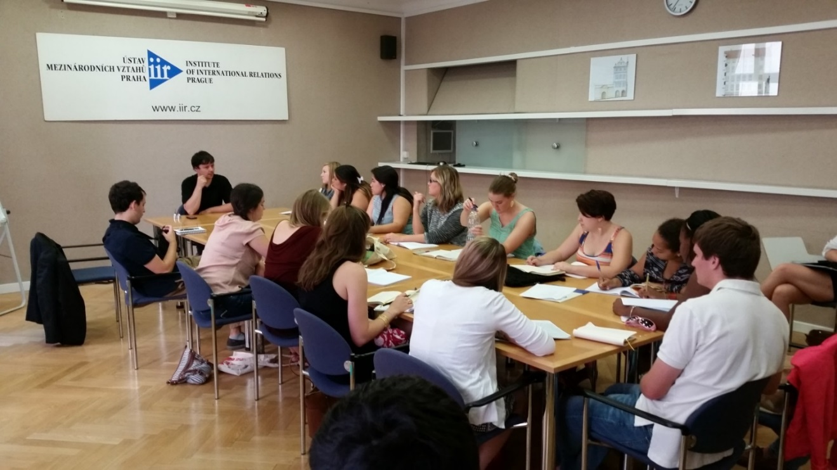
Faculty-led Programs
Courses in the Texas A&M catalog taught overseas;
International component is 2-18 weeks in length;
Faculty can teach collaboratively with a colleague at the host institution.

Slide 6
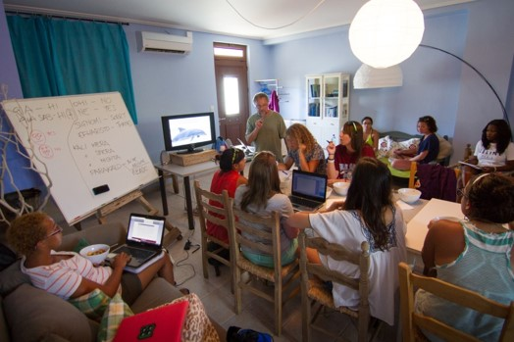
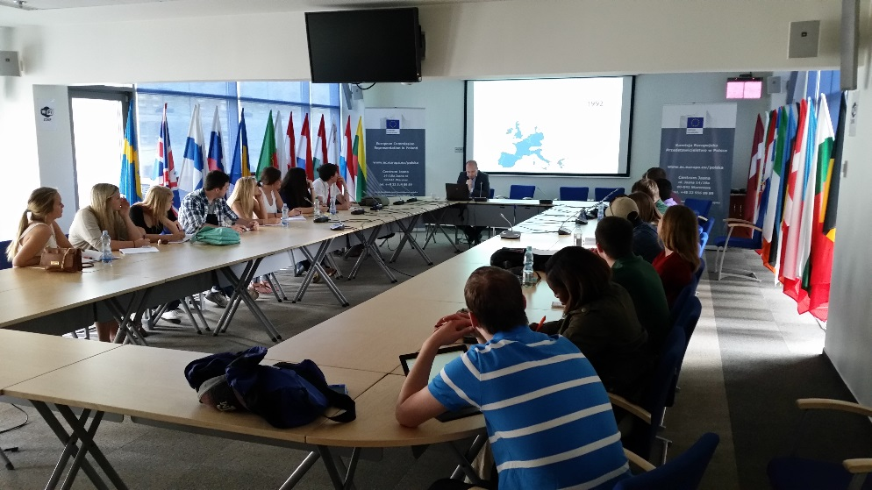
The process for creating
Faculty-led programs
Submit a Faculty-led program proposal to your department. The approval routes through the college dean’s office;
Once approved, the college sends the proposal to the Study Abroad Programs Office;
Deadlines (10-12 months in advance):
  Fall – October 1;
  Spring – March 1;
  Summer – May 1.

Slide 7
Role of the
Study Abroad Programs Office
Standard Service programs:
Study abroad advisor assigned to each program;
Assists with program logistics and itinerary;
Provides budget, contracts,
payments and charges;
Provides student advising and orientations;
Marketing and promotion;
Liaise with Registrar and Business Services.
Administrative fee charged to students: $400
Limited service programs:
Department or college provides most of the support with logistics, budget preparations, and business services;
Study abroad opens program applications, assists with student advising, liaises with registrar for course coding and opening in Howdy;
Administrative fee charged to students: $100

Slide 8
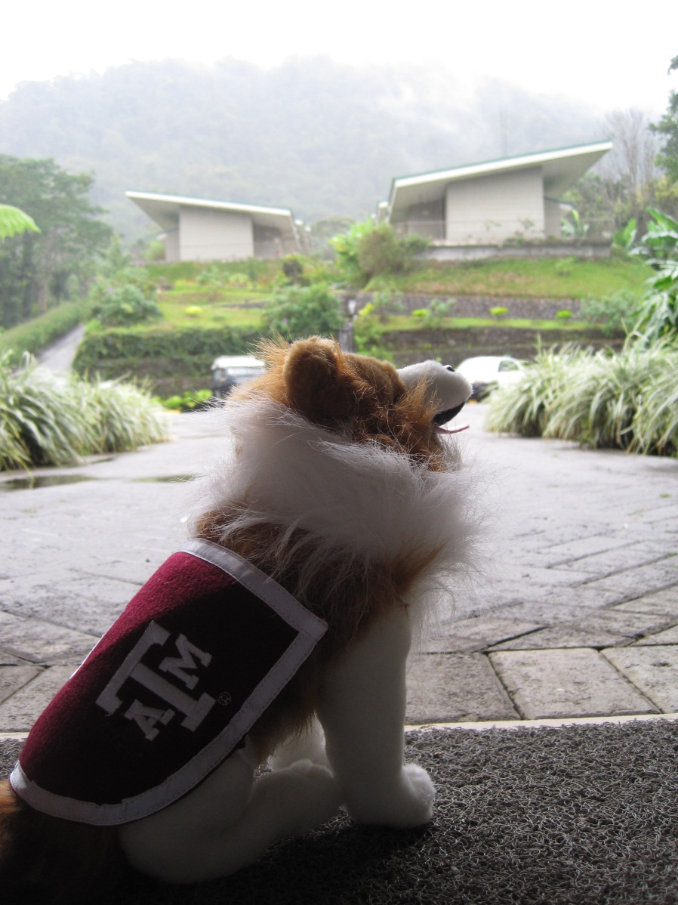
Role of the
Study Abroad Programs Office
For all faculty:
Briefings to help you prepare for taking students abroad;
24/7 support while you are abroad;
Enroll you and your students in CISI insurance – provides medical insurance and security support;
Provide health and safety orientations for your students.

Slide 9
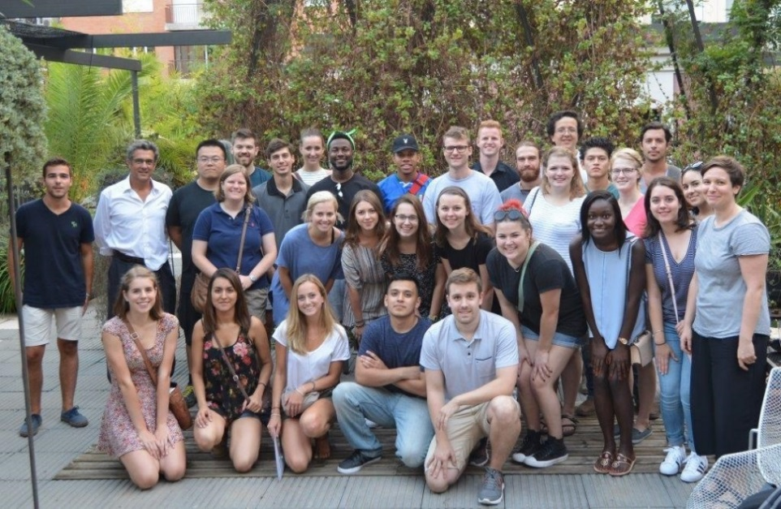
Frequently asked questions
Who pays my salary?
Whom do I talk to about my program and course ideas?
Why do I need to start planning
a year in advance?
Do I need to pay for my airfare
and other expenses?
How do I find logistical support
in the foreign country?
How do I recruit students?
Can my family come with me?

Slide 10
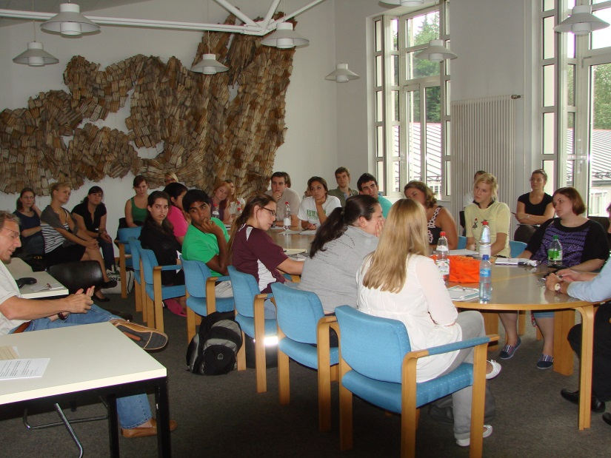
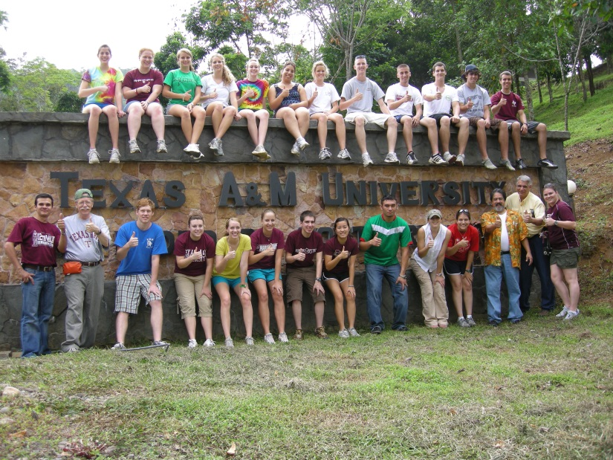
Field Trips
Courses taught on campus incorporating an international trip;
International component generally 1-2 weeks;
College/department handles the logistics, payments, and reservations.

Slide 11
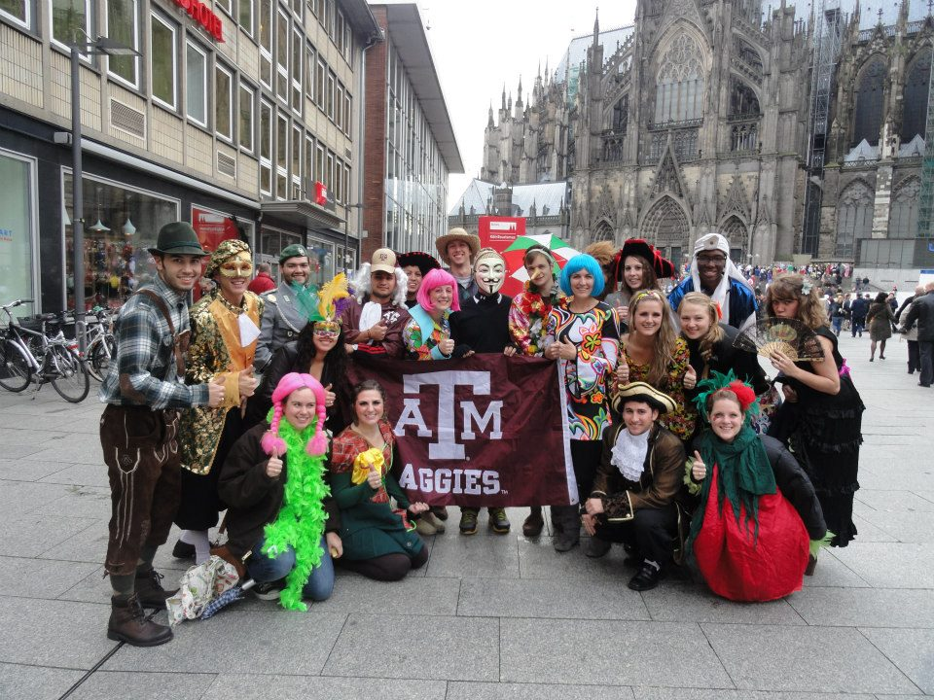
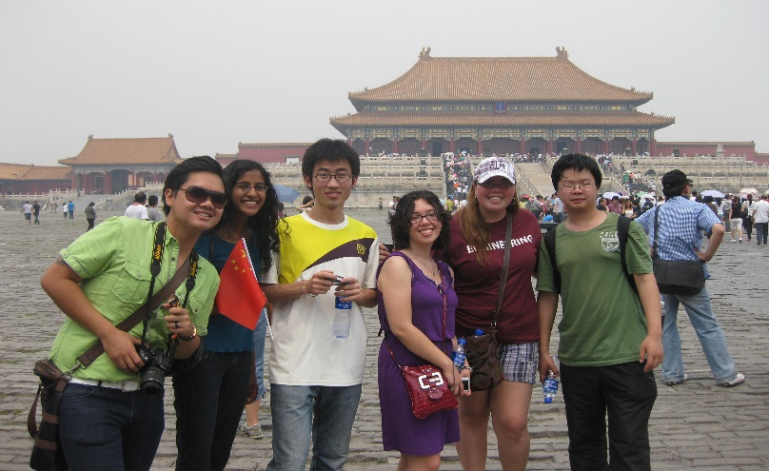
Field Trips –
Process for approval
Submit a Field Trip Fee Approval Form with itinerary and budget;
Deadlines:
  Fall – March 1
  Spring – September 1
  Summer – February 1
  Two part study abroad registration:
    Group leader/college liaison registers group
    Student participants complete individual registration.

Slide 12
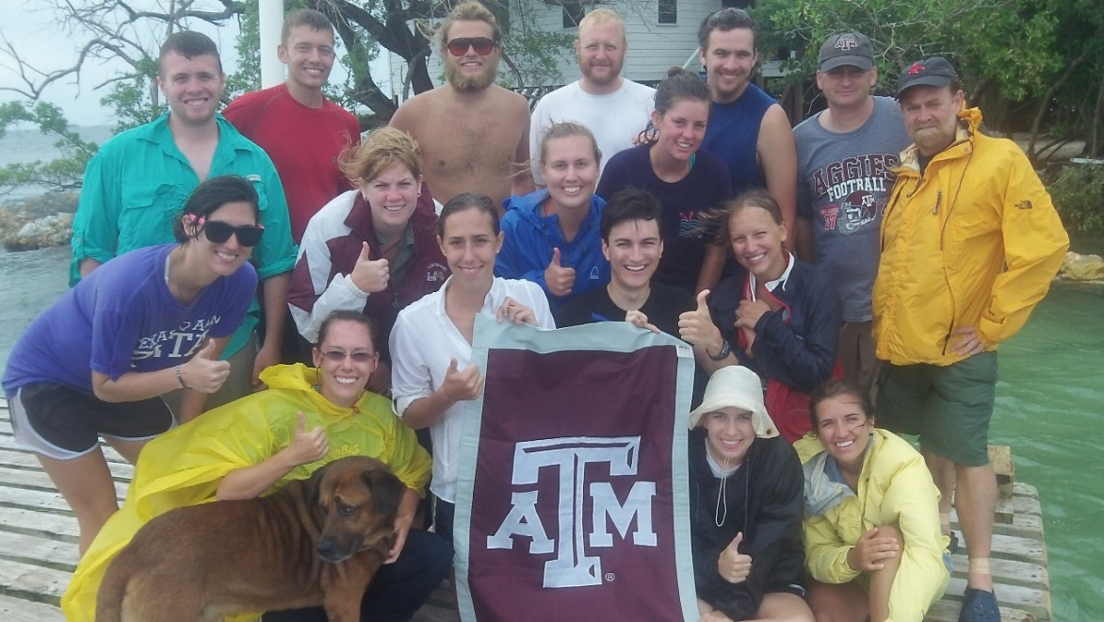
Role of the
Study Abroad Programs Office
Provide references for third party providers;
Liaise with college coordinator and/or group leader;
  Send registration instructions
  Select students based on roster/list provided
  Ensure all required information is submitted
Provide pre-departure information to program leaders.

Slide 13
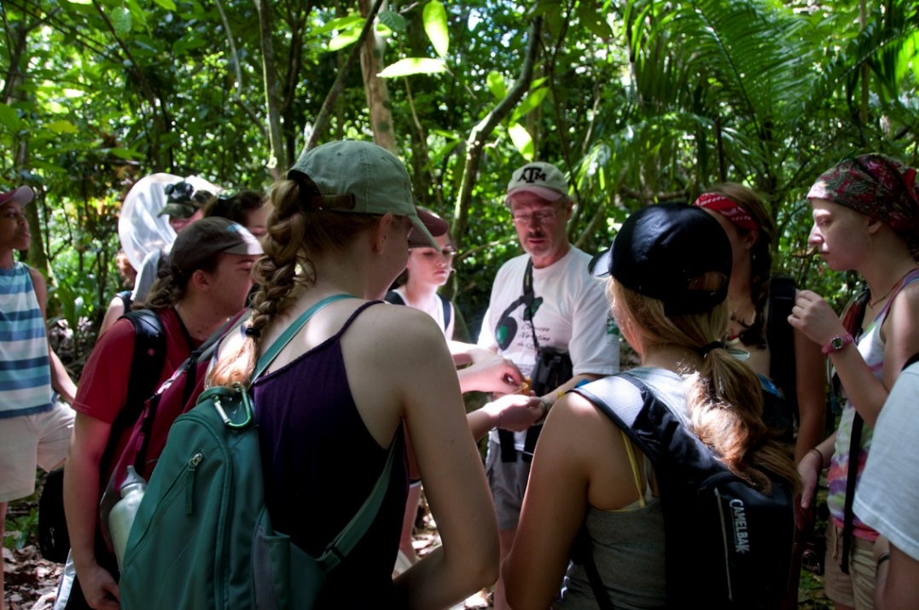
Role of the
Study Abroad Programs Office
Register all students and faculty in CISI insurance;
Briefings to help you prepare for taking students abroad;
24/7 support while you are abroad;
Bill the field trip administrative fee.

Slide 14
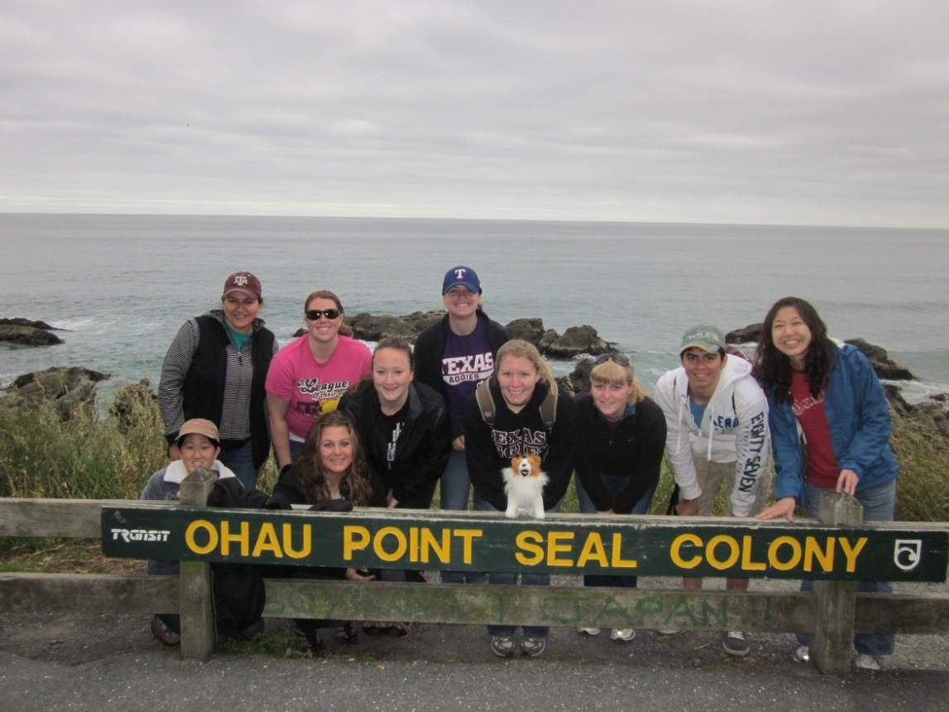
Research Abroad
Yes – students engaging in Texas A&M sponsored or affiliated research need to register with study abroad – there is no fee;
Most research opportunities are arranged by faculty or departments;
Students on research trips are not required to purchase the CISI insurance, but we highly recommend they do.

Slide 15
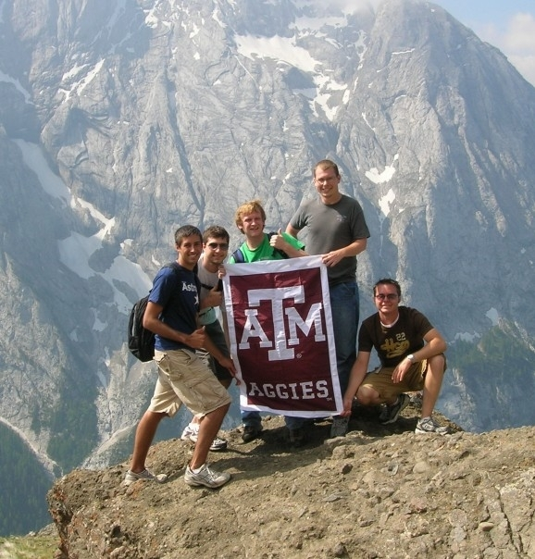
Resources provided for all faculty
Assistance in developing programs before you submit your proposal;
Advice regarding services in locations overseas;
Advising for the students on your programs;
Handling complicated problems with regard to health or other concerns.

Slide 16
Contact us with any questions or concerns
Study Abroad Programs Office
  First floor, Pavilion
Phone: 845-0544
http://studyabroad.tamu.edu
Emails:
  Jane Flaherty: jflaherty@tamu.edu
  Pascale Parker: pparker@tamu.edu
  Katy Lane: klane@tamu.edu

